Slide 1


Preliminary Oral Exam
Using MD Simulation to Resolve Structural Dynamics of a Spin-labeled Membrane Protein
Andrew Reid
Sep 16, 2015
Notes:
Merging Experimental and MD to determine protein dynamics in space and time. Space is: 1 to 100A. Time is: 2fs to 1us. EPR is 10 to 100A. 10ps to 1ms.

Slide 2
Background

Slide 3
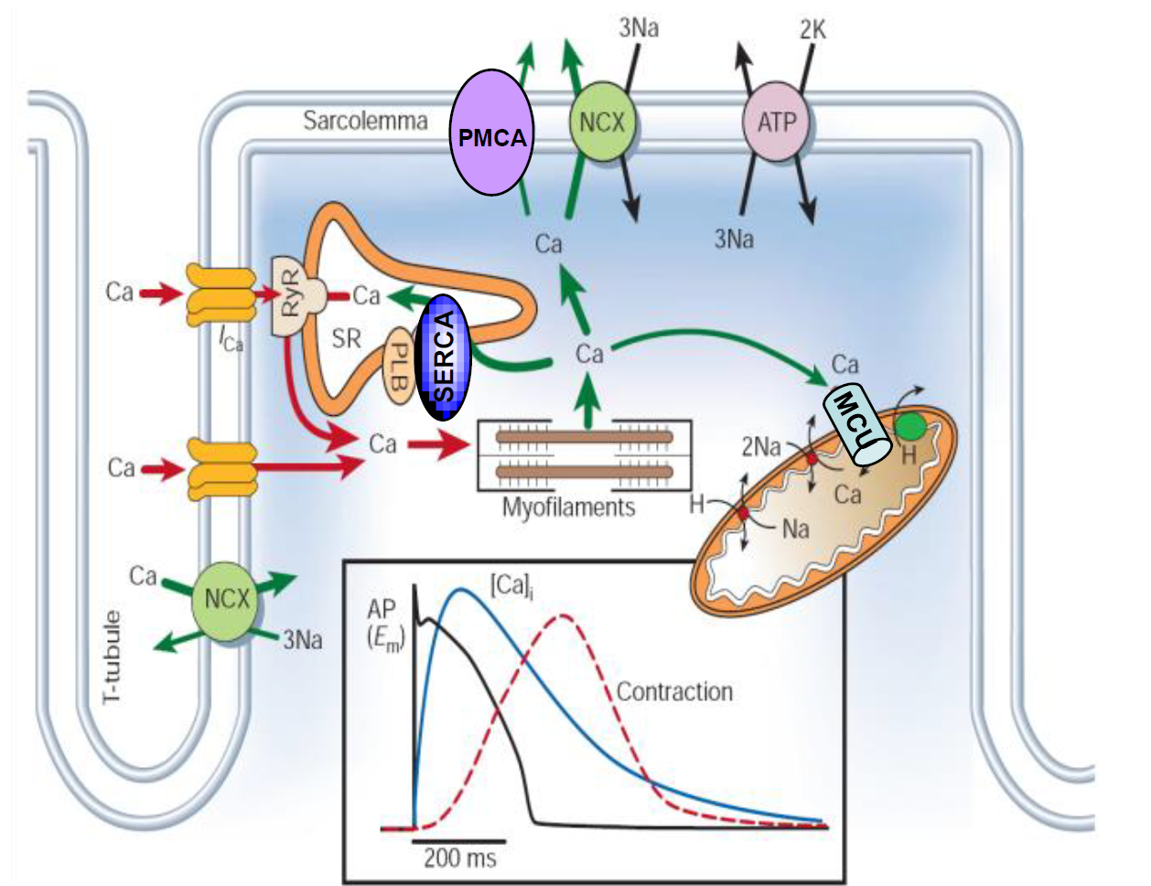
Calcium Transport Regulates Muscle Contractility
(Bers, Nature 2002)
Notes:
This is the interior of a muscle a cell. Calcium is stored at a high concentration in the SR.
During contraction, calcium is released into the cell, triggering the actin-myosin mechanism.
For relaxation, calcium must be removed from the cytosol. → next slide.

Slide 4
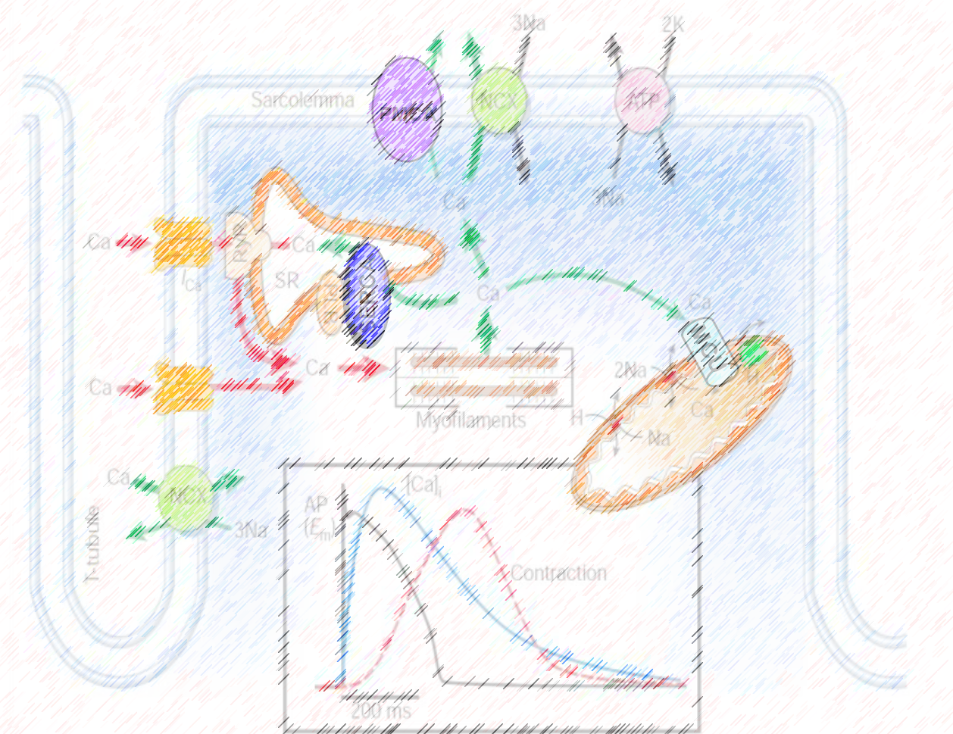
Calcium Transport Regulates Muscle Contractility
SERCA accounts for 70% of Ca²⁺ uptake in cardiac tissue.
PLB regulates SERCA activity.
Over-inhibition of SERCA by PLB is linked to heart failure.
(Bers, Nature 2002)
Notes:
The protein pump SERCA transports calcium ions back into the SR against a high concentration gradient.
… (read points).

Slide 5
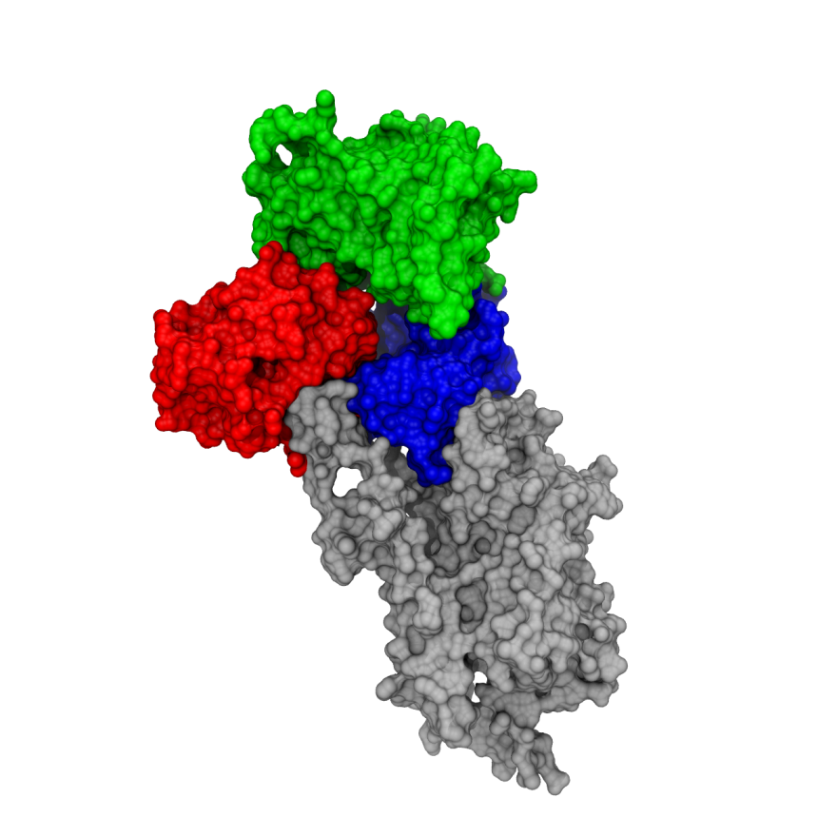
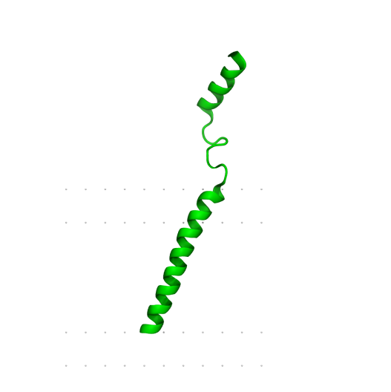
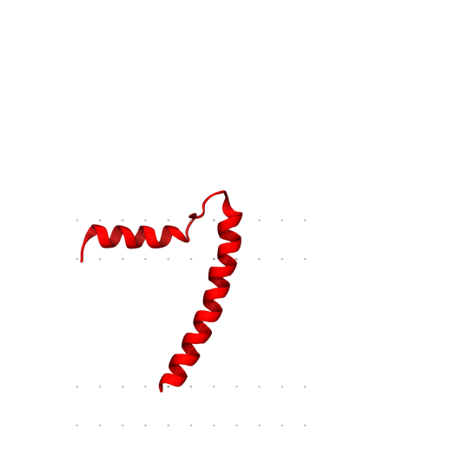
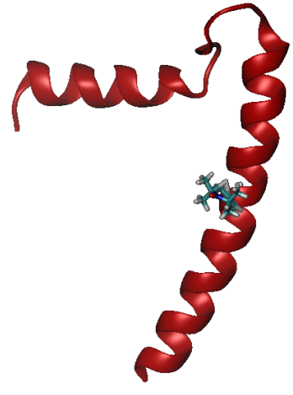
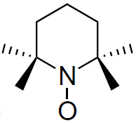
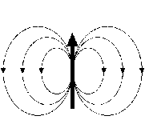
PLB Regulates SERCA
SERCA and PLB are trans-membrane proteins.
PLB Monomer possesses two structural states: Tense and Relaxed.
Phosphorylation at Ser16 relieves inhibition of SERCA.
The mechanism of inhibition relief is not fully understood.
Ca²⁺
ATP
ADP + P_{i}
R
Cytosol
T
P
Lumen
Ca²⁺
Electron Paramagnetic Resonance (EPR) spectroscopy and Molecular Dynamics (MD) simulation can elucidate this mechanism.
For EPR, a spin-label, such as TOAC, is attached to the protein.
μ
Notes:
Merging Experimental and MD to determine protein dynamics in space and time. Space is: 1 to 100A. Time is: 2fs to 1us. EPR is 10 to 100A. 10ps to 1ms.

Slide 6
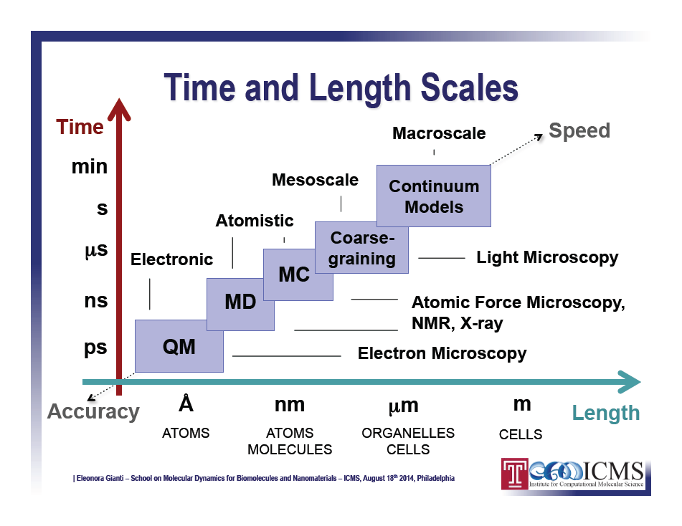
Notes:
We want to merge experiment and simulation to determine protein dynamics in space and time.
Molecular Dynamics is an atomistic model, just above full quantum mechanical models on the scale of speed vs. accuracy.
MD has 1A and 2fs and above.
EPR has 10 to 100A and and 10ps to 1ms.

Slide 7
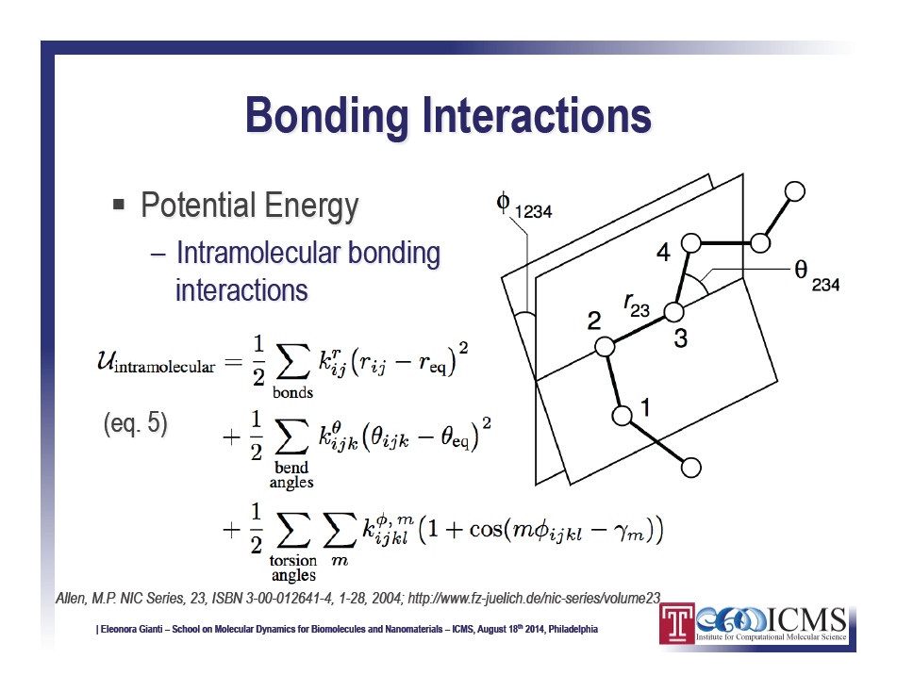
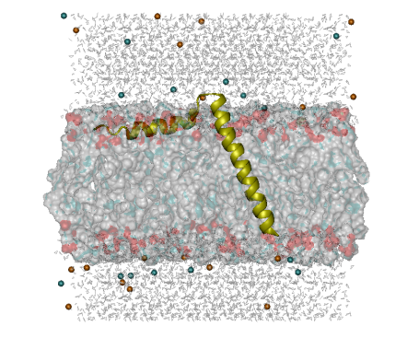
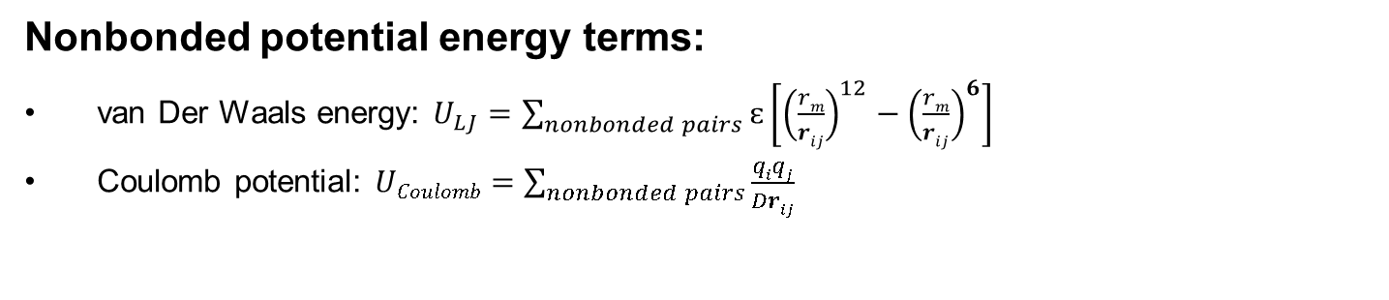
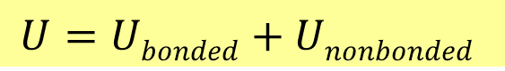
Using Molecular Dynamics (MD) Simulation
Force Field (CHARMM36):
$$U=Ubonded+Unonbonded$$
Bonded potential energy terms:
Nonbonded potential energy terms:
van Der Waals energy:$U_{LJ}=\sum_{nonbonded pairs}{ԑ\left[{\left(\frac{rm}{rij}\right)}^{12}−{\left(\frac{rm}{rij}\right)}^{6}\right] }$
Coulomb potential: $UCoulomb=\sum_{nonbonded pairs}{\frac{qiqj}{Drij} }$
( ~ r⁻⁶ )
( ~ r⁻¹ )
Notes:
In MD, at each timestep, we calculate bonded and nonbonded potential energy terms.
Bonded potential energy terms included 2-body, 3-body, and 4-body terms.
Nonbonded include van der Waals and Coulomb.

Slide 8
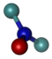
PLB EPR Measurement Coordinates
Experiment Frame
Probe Frame
CP Helix
z
θ_{MA}
M
P
M
A
10nm
H
z
P
A
θ_{PM}
x
y
θ_{AP}
TM Helix
y
φ_{PM}
A: “assembly” membrane normal
M: “molecule” PLB TM helix axis
φ_{AP}
P: “probe” TOAC z-principal axis
x
Relevant Orientations:
Probe-to-Molecule, Molecule-to-Assembly, and Probe-to-Assembly
Notes:
Once we have simulated trajectories, we want to analyze 3 frames of interest on spin-labeled protein: the assembly (bilayer normal in green), molecule (protein transmembrane helix in red), and the probe (TOAC in blue), where these vectors are the z-axis of each frame.
Probe principal axes are standard orbital axes. Z-axis points in direction of the pi-orbital.
We want to determine the Molecule-to-Assembly orientation. Later we can add SERCA. EPR is sensitive to the probe-to-assembly orientation. So, we need the probe-to-molecule info to complete the mapping. Previously this has been provided X-ray crystallography. However, MD modeling of the spin label occupancy has the primary advantage of being derived from a dynamic model.

Slide 9
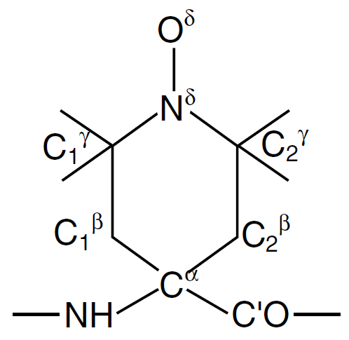
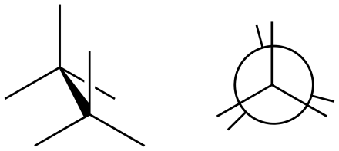
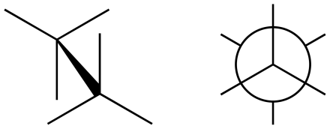
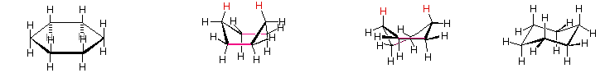
TOAC Conformers
TOAC probe
eclipsed
staggered
(Marsh 2006)
Conformations of free six-membered ring (cyclohexane):
Planar Structure
“Boat”
“Twist Boat”
“Chair”
Energetically
preferred
William Reusch, MSU, 2014
http://www2.chemistry.msu.edu/faculty/reusch/virttxtjml/sterism2.htm
Notes:
The probe’s z-axis orientation relative to the protein will depend on the structural dynamics of the six-membered ring.
Here are common conformations of a free six-membered ring. The probe attachment environment may also impact energetically favorable states.

Slide 10
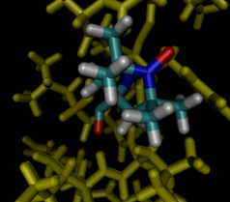
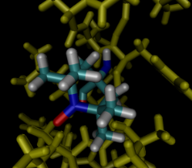
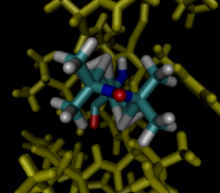
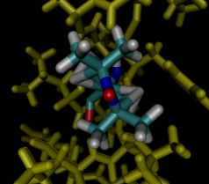
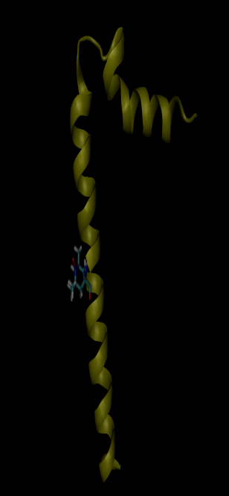
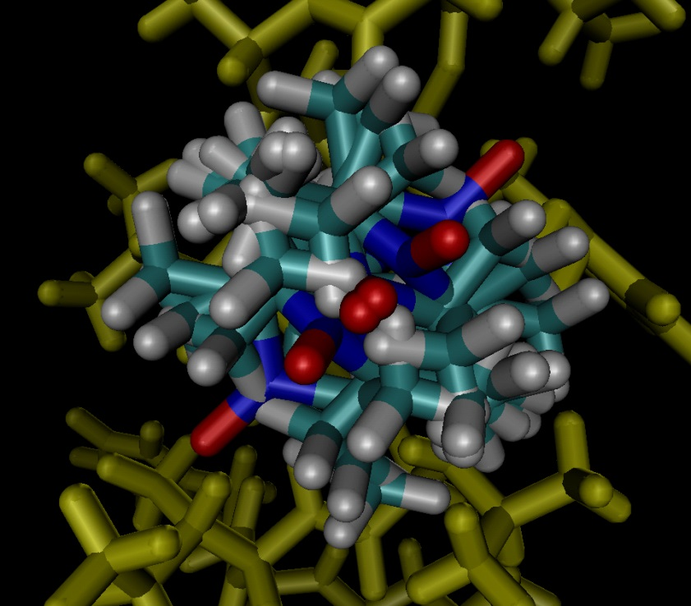
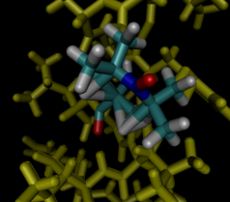
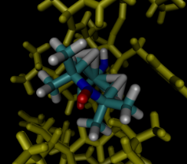
Model Builds of TOAC Conformers
Side View: TOAC conformers
TOAC probe
boat 1
boat 2
(Marsh 2006)
twistboat 1
twistboat 2
Side View: TOAC conformer ensemble at 36-Ala
chair 1
chair 2
Notes:
We used built 6 starting conformations of TOAC in the simulations.

Slide 11
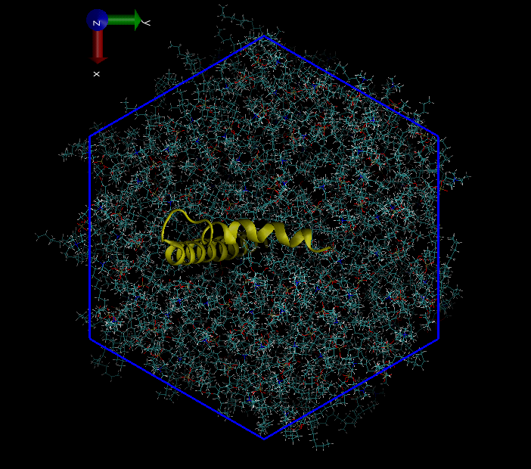
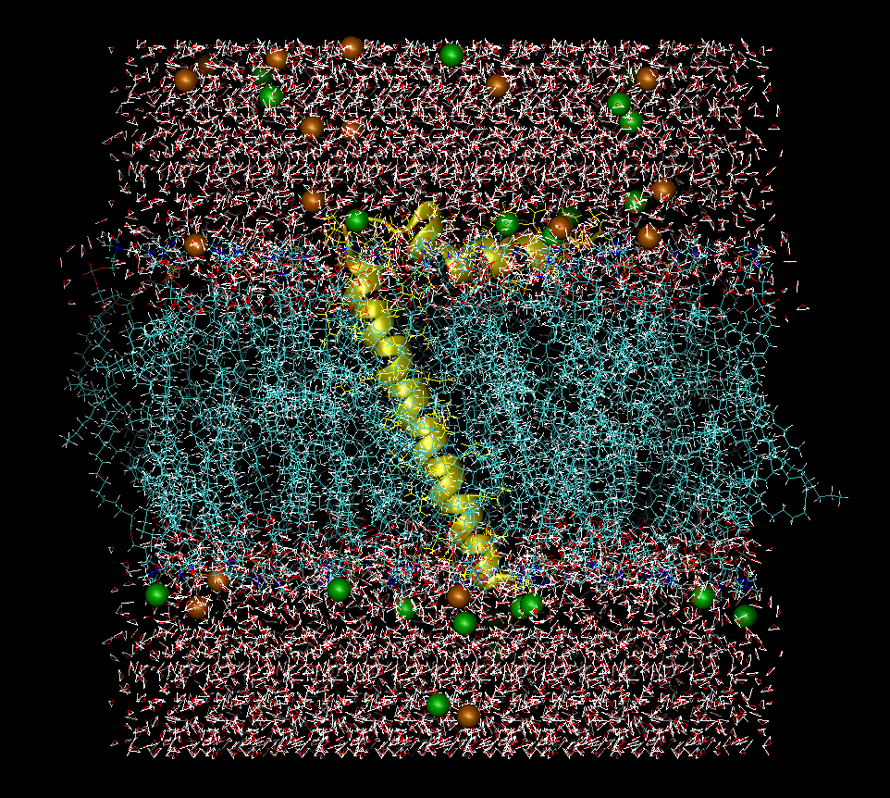
MD Simulation Environment
20 Å
14 Å
20 Å
88 Å
75 Å
20 Å
Lipid bilayer environment using CHARMM-GUI (Jo 2009)
DOPC or 1:1 POPC:DMPC lipids
Solvated & Ionized: 0.15M KCl
Wrapped boundary conditions
Spacing of 34Å sufficient to avoid protein self-detection across boundary planes
CHARMM36 force field
Temperature 298 K
Timestep 2 fs

Slide 12
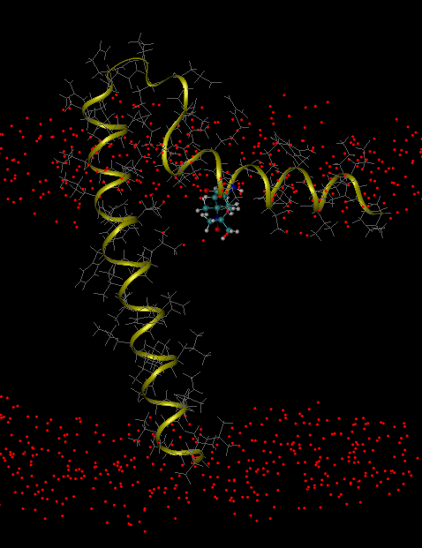
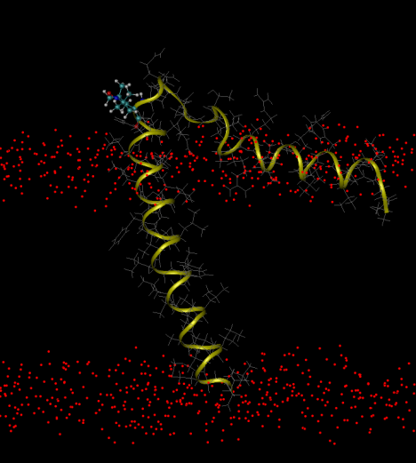
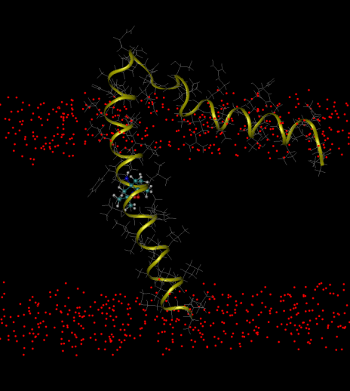
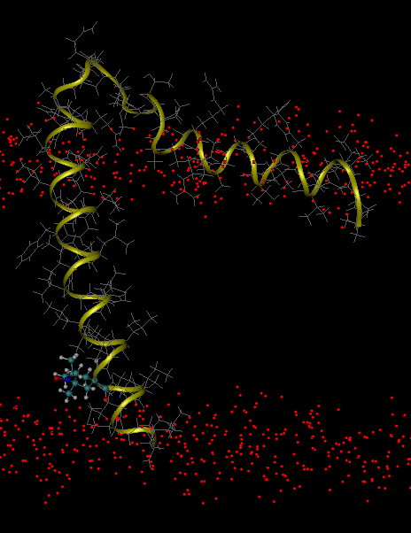
TOAC Label Positions for MD
24
11
36
46
TOAC attachment positions on PLB. Spin label TOAC was substituted for residues 11, 24, 36, and 46. Red: Bilayer headgroup oxygen atoms.

Slide 13
TOACMD Goals:
.
Compare protein structure between MD and NMR. (molecule-to-assembly)
Determine model of TOAC structural dynamics from MD simulation. (probe-to-molecule)
Compare TOAC orientation and order parameter between MD and EPR. (probe-to-assembly)
Notes:
Say: I’ll focus on #2 and #3.

Slide 14
TOACMD Goals:
.
Compare protein structure between MD and NMR. (molecule-to-assembly)
Determine model of TOAC structural dynamics from MD simulation. (probe-to-molecule)
Compare TOAC orientation and order parameter between MD and EPR. (probe-to-assembly)
Notes:
Say: I’ll focus on #2 and #3.

Slide 15
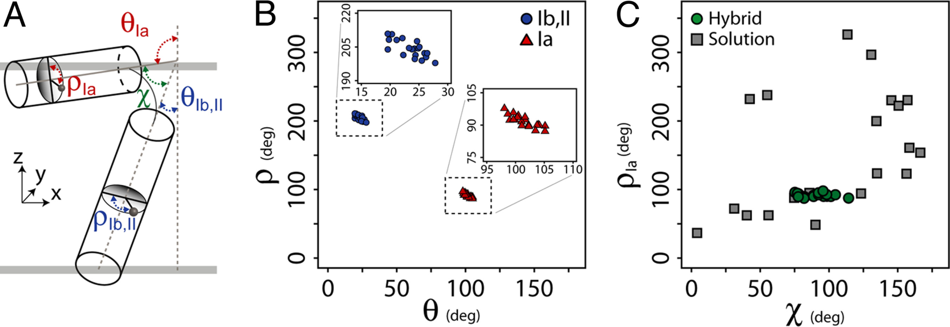
TOACMD Goal 1:
Compare protein structure for MD simulation vs. NMR spectroscopy. (molecule-to-assembly)
vs.

Slide 16
Previous NMR on PLB (PDBID: 2KB7)
Reports 20 lowest-energy conformers
Measures α-helix geometry in membrane
(Veglia 2009)
Ia: cytoplasmic domain
Ib: loop domain
II: transmembrane domain
NMR Model Averages – PDBID: 2KB7
Transmembrane Helix:
Ɵ_{Ib,II} = Ɵ_{PM} = 24 ± 2°
ρ_{Ib,II} = 204 ± 4°
Ɵ_{Ia} = 102 ± 2°
ρ_{Ia} = 92 ± 3°
Ɵ_{PM} = 24 ± 2°
ρ = 204 ± 4°
Notes:
Fig. 3. Comparison between the solution NMR ensemble and the conformational ensemble generated with the hybrid protocol. (A) Angles used to
describe the topology of monomeric AFA-PLN. (B) Rotation () versus tilt angle () for the 20 structures in the deposited ensemble. The Insets better allow
for variations to be seen in the angles describing the topology with respect to the membrane normal for domains Ib and II (Left, circles) and domain Ia
(Right, triangles). (C) Comparison of the ensemble of structures generated from solution NMR restraints alone (squares) with the hybrid solution and
solid-state NMR method (circles).

Slide 17
MD vs. NMR: Ɵ_{AM} agreement
Ɵ_{AM}
Probe Frame
z
P
M
θ_{AM}
NMR (2009)
A
y
x
A: “assembly” membrane normal
M: “molecule” PLB TM helix axis
TM helix fluctuates around stable equilibrium.
Initially set at ~15°, centers on 24° by 15ns.
P: “probe” TOAC principal axis

Slide 18
MD vs. NMR: Ɵ_{AM} agreement
Combined MD Distribution
Ɵ_{AM}
NMR (2009)
Gaussian Fitting Parameters:
TM to Mem Angle | Average | St Dev.
MD Avg. Fit | 24.1° | 4.8°
NMR (2009) | 24° ± 2 | ---
2KB7(0) runs | 23.8° | 3.7°
2KB7(5) runs | 24.4° | 5.8°
TM helix fluctuates around stable equilibrium.
Initially set at ~15°, centers on 24° by 15ns.
*Distributions calculated from 15 to 100ns

Slide 19
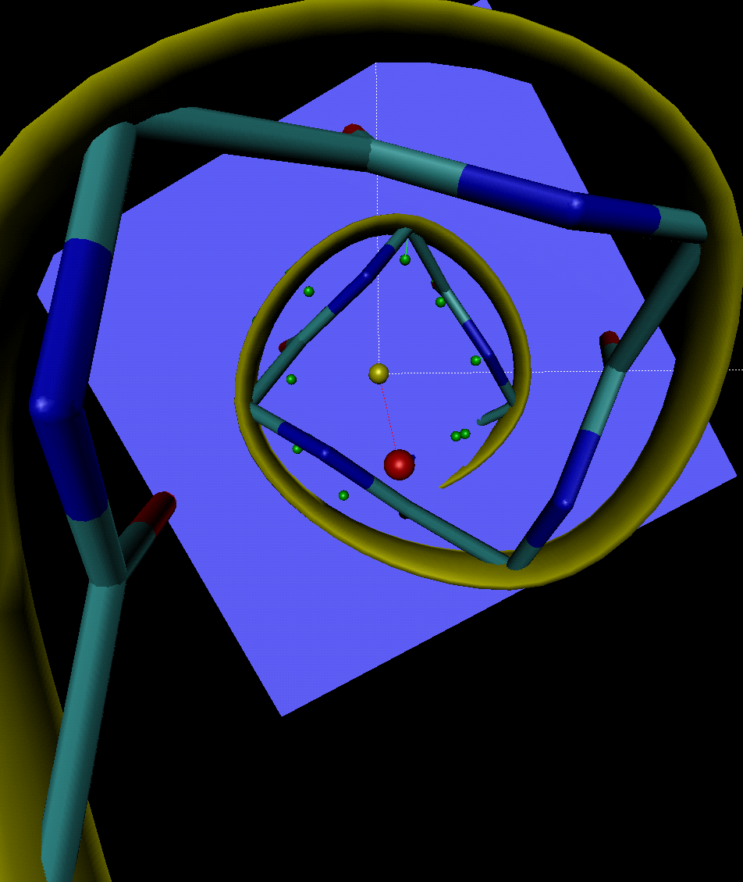
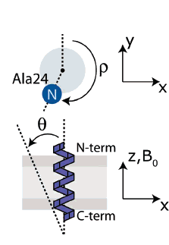
MD vs. NMR: ρ_{Ib,II} “TM helix azimuthal”
Algorithm – L:\Reid\Sim\How-To\Self-azimuthal angle analysis script.pptx
y
TM tilt geometry determines axes:
x-axis lies in the plane swept by helix tilt, perpendicular to helix axis (below).
y-axis determined by x-axis and helix axis.
x
ρ
View down helix
at selected residue
Azimuthal angle, ρ, as defined in Veglia NMR structures (2006)

Slide 20
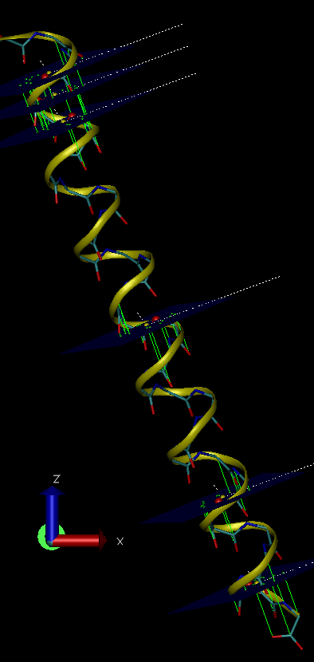
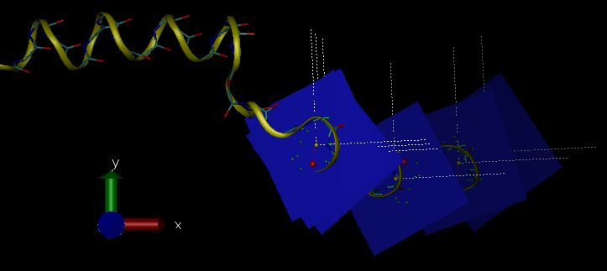
Measured ρ_{Ib,II} for multiple residues:
PLB, 2KB7(0) in DOPC, 298K, 460ns
2KB7(0) side view
2KB7(0) top-down view
Compare azimuthal angle, rho, to NMR data.
Compare between MD runs:
comparison between residues highlights “helical stability”
NEXT: Run script on runs to detect:
Effect of lipid composition
Effect of PLB conformer – 2KB7 (0) vs. (5)
Calculated residues: 24, 25, 26, 37, 46, 51
The top residue, Ala24, visually agrees with NMR prediction of ρ ~ 204±4°
Extended NMR Ala24 prediction to other residues, assuming 100°/residue
Residue | 24, NMR | 25 | 26 | 37 | 46 | 51
Angle, ρ | 204° ± 4° | 304° | 44° | 64° | 244° | 24°

Slide 21
PLB, 2KB7(0) in DOPC, 298K, 460ns
26
NMR prediction
100°
25
100°
24

Slide 22
TOACMD Goals:
.
Compare protein structure between MD and NMR. (molecule-to-assembly)
Determine model of TOAC structural dynamics from MD simulation. (probe-to-molecule)
Compare TOAC orientation and order parameter between MD and EPR. (probe-to-assembly)
Notes:
Say: I’ll focus on #2.

Slide 23
TOACMD Goal 2:
Determine model of TOAC structural dynamics from MD simulation. (probe-to-molecule)
M
θ_{pm}
z_{p}
φ_{pm}
x
y
Probe-to-Molecule orientation defined by spherical coordinates in probe frame.

Slide 24
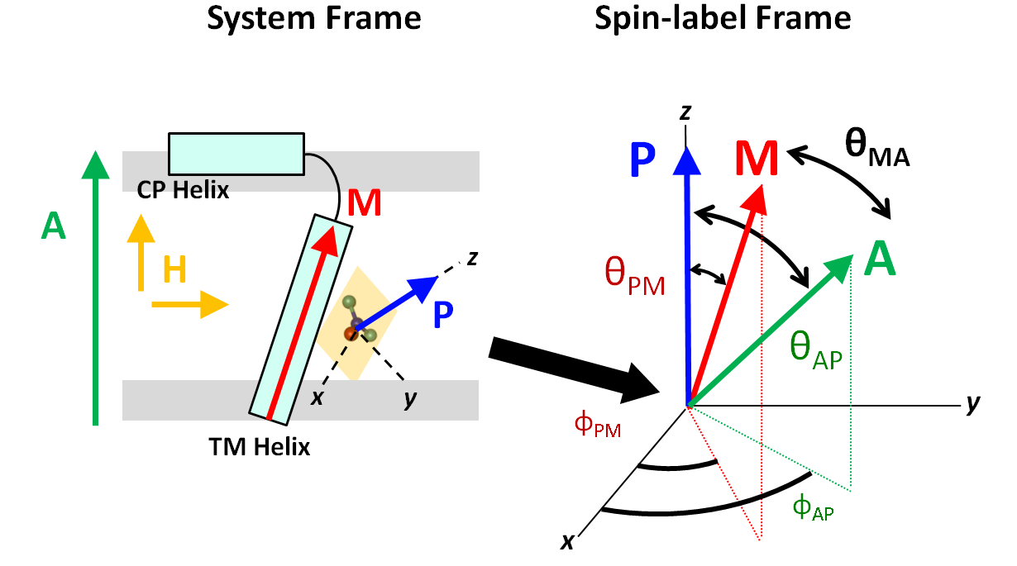
MD Angle Trajectories
Probe-to-Molecule
Assembly Frame
Probe Frame
4 ns
Molecule-to-Assembly
Probe-to-Assembly
Angle trajectories from MD of 36-TOAC-PLB. Probe (P) orientation angles relative to molecule (M) and assembly (A), which corresponds to the normal of the membrane bilayer. The dashed line shows published NMR data of Helix-to-Bilayer angle (θ_{MA} ~ 24°).

Slide 25
TOAC Structural Dynamics Model → MD trajectories of probe-to-molecule orientation suggest TOAC flips between two distinct conformations on ~1ns timescale
36-TOAC-PLB: Probe-to-Molecule
Probe Frame
z
.002 ns resolution
P
M
θ_{PM}
θ_{PM}
y
x
φ_{PM}
M: “molecule” PLB TM helix axis
P: “probe” TOAC principal axis
4 ns

Slide 26
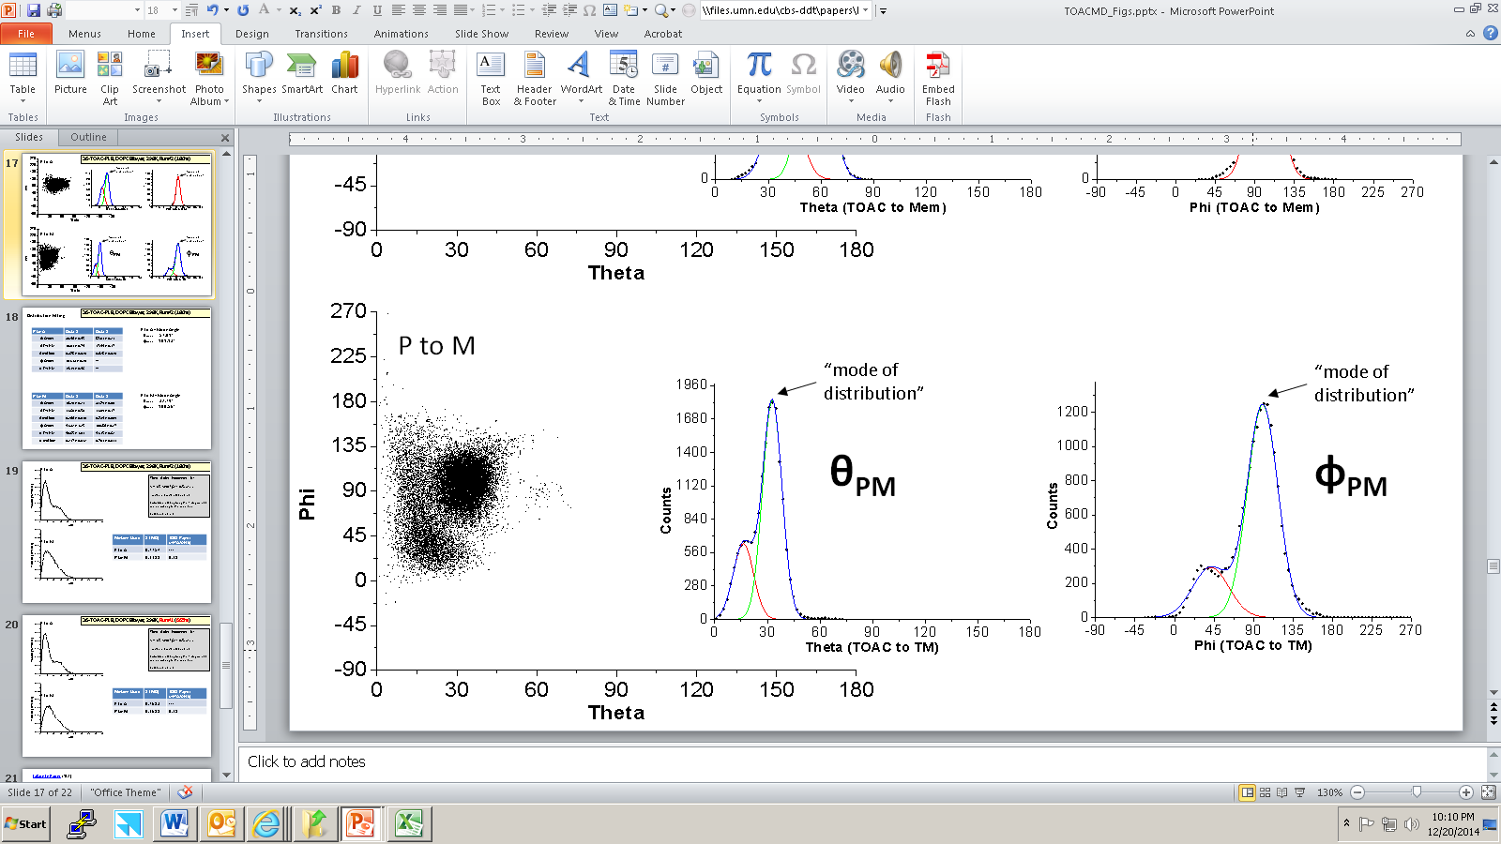
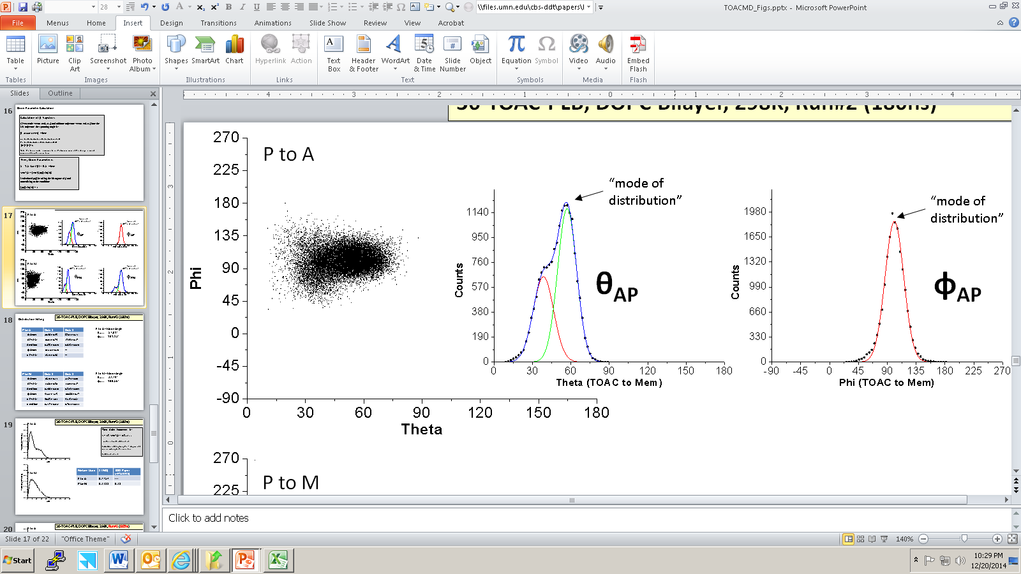
TOAC Structural Model
Probe-to-Molecule
36-TOAC-PLB model (1μs run)
rel. frequency
rel. frequency
φ_{PM}
θ_{PM}
_{θPM}
Probe-to-Assembly
φ_{AP}
rel. frequency
rel. frequency
θ_{AP}

Slide 27
TOAC Structural Model
Probe-to-Molecule
36-TOAC-PLB model (1μs run)
rel. frequency
rel. frequency
φ_{PM}
θ_{PM}
_{θPM}
Probe-to-Assembly
φ_{AP}
rel. frequency
rel. frequency
θ_{AP}

Slide 28
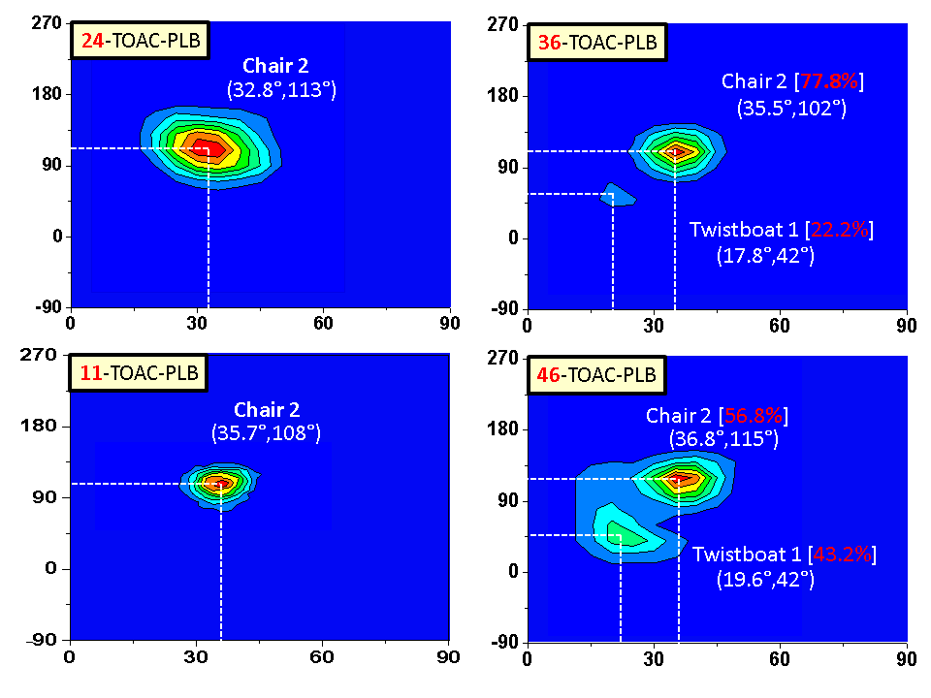
TOAC States by Location (Probe-to-Molecule)
φ_{PM}
φ_{PM}
θ_{PM}
θ_{PM}

Slide 29
11,24,36,46-TOAC Orientation (Probe-to-Molecule)
TOAC Position | TOAC Primary “Chair2” |  |  |  |  | TOAC Secondary “Twistboat 1”
 | Mol frac | θ_{PM} | Δθ_{PM} | φ_{PM} | Δφ_{PM} | θ_{PM} | Δθ_{PM} | φ_{PM} | Δφ_{PM}
11 | 1.000 | 35.7° | 10.8° | 108° | 34° | --- | --- | --- | ---
24 | 1.000 | 32.8° | 20.3° | 113° | 61° | --- | --- | --- | ---
36 | 0.778 | 35.5° | 13.5° | 102° | 41° | 17.8° | 12.9° | 42° | 45°
46 | 0.568 | 36.8° | 15.0° | 115° | 49° | 19.6° | 15.3° | 42° | 49°
ΔΘ_{PM} is the FWHM (full width half max) by component of the bimodal fit.
These runs have POPC-DMPC lipid composition with PLB conformer (5), run for 100ns.
TOAC conformational occupancy model:
Probe-to-Molecule angle distribution differs among positions 11, 24, 36, and 46.
Distributions characterized by: center, width, modality.
Solvent-accessible 11 and 24 show single mode “chair2”.
Intra-membrane 36 and 46 show bimodal “chair2” and “twistboat1”.

Slide 30
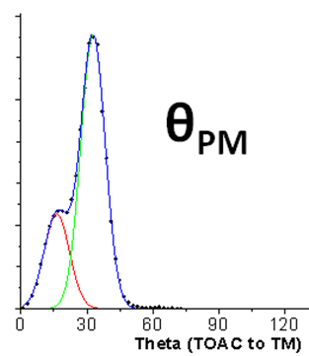
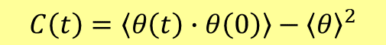
Simulation Dynamics Timescales: Probe dynamics vs. Molecule dynamics
Probe-to-Molecule
Probe-to-Assembly
θ_{PM}
θ_{AP}
Distributions for orientations Probe-to-Molecule and Probe-to-Assembly are resolved from θ vs. φ scatter plots by a bimodal Gaussian fit. The θ distributions are plotted cumulatively over time, showing Probe-to-Molecule converges by ~30ns and Probe-to-Bilayer converges by ~1μs. Plotted points are centers of a bimodal Gaussian fit. The pale lines span the FWHM.
Probe-to-molecule distribution convergence
by ~30ns
Probe-to-assembly distribution convergence
by ~1000ns
Next step:
Given distribution convergence,
we can calculation temporal ACF’s →
$$C\left(t\right)=\left\langle θ\left(t\right)∙θ\left(0\right)\right\rangle −{\left\langle θ\right\rangle }^{2}$$

Slide 31
MD vs. X-ray Crystallography: TOAC Ɵ_{PM} agreement
Probe Frame
Ran Minimization on 36-TOAC-PLB Builds
z
P
TOAC conformer | _{MD 2KB7(0)} | _{MD 2KB7(5)} | MD average | 2006 X-Ray
Chair2 | 32.5 | 30.5 | 31.5 | ---
Twistboat1 | 16.0 | 13.4 | 14.7 | 13.3 ± 2.2°
Twistbaot2 | 63.4 | 64.6 | 64.0 | 64.9 ± 3.2°
M
θ_{PM}
y
x
φ_{PM}
These three conformations stabilized during MD minimization.
The chair 1 conformation was unstable → flipped during minimization.
M: “molecule” PLB TM helix axis
MD agreement with X-ray Crystallography supports accuracy of MD TOAC model topologically.
Angle distribution peak locations are accurate, despite possible deviations in mol fraction.
P: “probe” TOAC principal axis

Slide 32
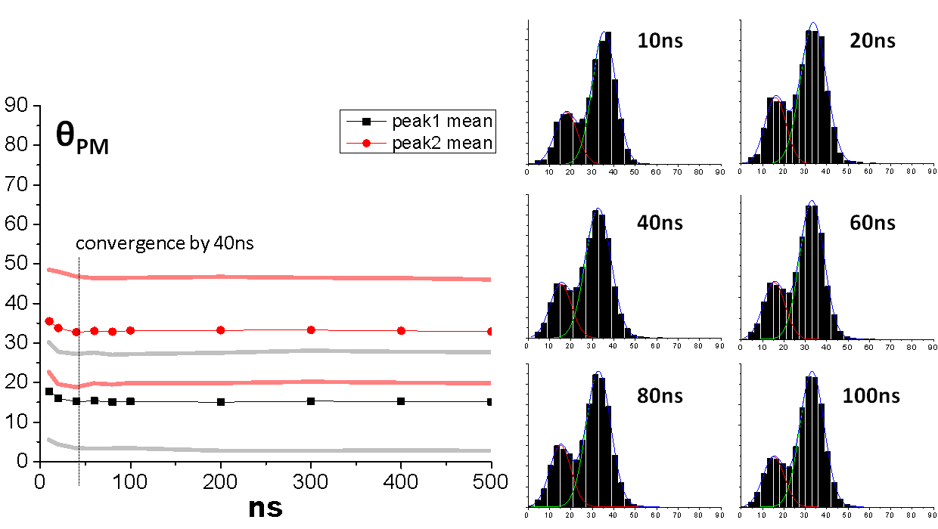
Did we run the MD long enough? –Simulation Convergence–
36-TOAC-PLB: 500ns excerpt
Probe Frame
Probe-to-Molecule
z
P
θ_{PM}
M
y
x
φ_{PM}
Simulation convergence is requisite to statistically determine angle distributions for characterization of the probe-to-molecule, probe-to-bilayer, and probe-to-bilayer orientations.
Trajectory data is binned to histograms cumulatively, and the cumulative fit centers and FWHM plotted against simulation duration in the following figures.
The convergence test is satisfied once the center and FWHM of the distribution plateaus.
M: “molecule” PLB TM helix axis
P: “probe” TOAC principal axis

Slide 33
TOACMD Goals:
Compare protein structure between MD and NMR. (molecule-to-assembly)
Determine model of TOAC structural dynamics from MD simulation. (probe-to-molecule)
Compare TOAC orientation and order parameter between MD and EPR. (probe-to-assembly)
Notes:
Say: I’ll focus on #2.

Slide 34
TOACMD Goal 3:
Compare TOAC orientation and order parameter for MD simulation vs. EPR spectroscopy. (probe-to-assembly)
vs.

Slide 35

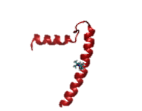
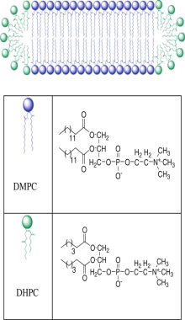
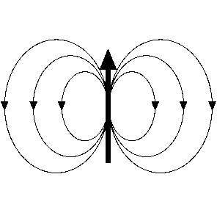
EPR Probes Protein Orientation
PLB spin-labeled at Ala-36
Oriented Bicelle EPR Spectra
H
P
TOAC
spin-label
EPR acquires spectra sensitive to probe orientation in magnetic field.
Simulating EPR spectra to match data provides probe orientation angles.
EPR simulation must assume a probe conformation occupancy model.
Notes:
Say:

Slide 36
36-TOAC-PLB Orientation (1μs run)
Probe-to-Molecule
Probe-to-Assembly

Slide 37
MD vs. EPR: TOAC Orientation (Probe-to-Assembly)
MD: Orientation Angles (1μs run of 36-TOAC-PLB):
TOAC Position | TOAC Primary “Chair2” |  |  |  |  | TOAC Secondary “Twistboat 1”
 | Mol frac | θ_{PA} | Δθ_{PA} | φ_{PA} | Δφ_{PA} | θ_{PA} | Δθ_{PA} | φ_{PA} | Δφ_{PA}
36 | 0.894 | 57.4° | 27.0° | 97.7° | 34° | 32.7° | 12.8° | 97.7° | 34°
EPR: 36-TOAC-AFA Bicelle MD-constrained Fit:
A(x,y,z) = 6.00 6.00 33.40
g(x,y,z) = 2.00970 2.00680 2.00270
R(x,y,z) = 7.93 7.93 5.50
Tc(x,y,z) = 1.96ns 1.96ns 523.98ns
Component 1:
molFrac = 0.59
alphaD = 0.00
betaD = 32.7
gammaD = -109.17
C20, C22, C40 = 4.69 -3.98 1.11
MD TOAC Secondary
Component 2:
molFrac = 0.41
alphaD = 0.00
betaD = 57.4
gammaD = 91.16
C20, C22, C40 = 0.75 2.33 -2.41
MD TOAC Primary
MD sim TOAC model corroborates EPR spectrum up to angle centers, with differing mol fraction.

Slide 38
MD vs. EPR for TOAC Positions: 24, 46
Ran 36-TOAC-PLB to 1μs to fully sample probe-to-assembly distribution.
Ran 24,46-TOAC to 100ns to fully sample probe-to-molecule distribution.
Can we analyze 24,46-TOAC-PLB in a way that avoids running each to 1μs?
Yes…

Slide 39
MD to EPR Comparison for 24,46-TOAC-PLB
Analysis: Combine 1μs molecule dynamics with 100ns probe dynamics
Have: 100ns MD for 24-TOAC sufficiently sampling probe-to-molecule distribution
Add: 1000ns MD for 36-TOAC sufficiently sampling molecule-to-assembly distribution
“Probe Dynamics”
24-TOAC-AFA (100ns)
(x10)
“Full Dynamics (EPR)
24-TOAC-AFA (1000ns)
Combine trajectories with angle mapping geometry
Get:
→ Angle Distributions
→ Order Parameters
“Molecule Dynamics”
36-TOAC-AFA (1000ns)
Problem: Insufficient mapping f(θ_{MA}): {θ_{PM},φ_{PM}} → {θ_{AP}, φ_{AP}}
Angle mapping trigonometry → Need more angles than θ_{MA}

Slide 40
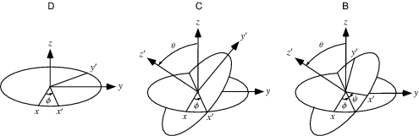
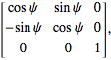
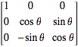


MD to EPR Comparison for 24,46-TOAC-PLB
Analysis: Combine 1μs molecule dynamics with 100ns probe dynamics
Calculate reference frame transformation using Euler Angles: Ω = (φ, θ, ψ)
sufficient: 3 angles fully define transformation.
general: transform any vector among frames.
R(Ω) =
so that $\overset{⃑}{v}′=\text{R}\text{(}\text{Ω}\text{)} \overset{⃑}{v}$ for any $\overset{⃑}{v} ∈R^{3}$
(z-x-z convention from Mathematica Documentation, May 2015)
Assembly:
Molecule:
Probe:
x_{A}, y_{A}, z_{A}
x_{M}, y_{M}, z_{M}
x_{P}, y_{P}, z_{P}
36-TOAC
Probe → Molecule: P₃₆ → M₃₆ : R(Ω₃₆^{P→M})
Molecule → Assembly: M₃₆ → A₃₆ : R(Ω₃₆^{M→A})
Probe → Molecule → Assembly: R(Ω₃₆^{P→A}) = R(Ω₃₆^{P→M}) R(Ω₃₆^{M→A})
24-TOAC
Probe → Molecule: R(Ω₂₄^{P→M})
Molecule → Assembly: R(Ω₃₆^{M→A})
Probe → Molecule → Assembly: R(Ω₂₄^{P→A}) = R(Ω₂₄^{P→M}) R(Ω₃₆^{M→A})
We’ve worked out the math and are currently doing this analysis:
To get S, need: β(t) = f(Ω₀,Ω(t)):
Calculate Ω(t) from xyz coords
Determine “mode” angles, Ω₀
Find, f, to relate (Ω₀,Ω(t))→ β(t)

Slide 41
Research Directions:
TOACMD publication
After this include SERCA in SERCA-PLB
Merge MD and EPR
MD can provide testable hypotheses
Use EPR results to constrain MD simulations
Further Studies:
Refine EPR analysis using MD information
MD to EPR direct spectra calculation
Notes:
MD can provide testable hypotheses for EPR experiment, e.g. mutation experiment of important aa for protein structure.
MD gives atomistic models that extend resolution to atomistic level. Atomistic models will give more details than experiment.

Slide 42
Acknowledgements
Jesse McCaffrey
Peter Martin
Bengt Svensson
Ben Binder
David D. Thomas
Thank you for serving as my Oral Exam committee!
→ Questions?

Slide 43


Slide 44








EPR Spectroscopy
Magnetic dipole moments of electron and nucleus:
Hamiltonian for Zeeman effect and Hyperfine splitting corrections:
with energy eigen-values:
so: , where
Then, the resonance condition, , becomes:
Note that g and T are orientationally sensitive:

Slide 45

Build Logo

